Slide 1

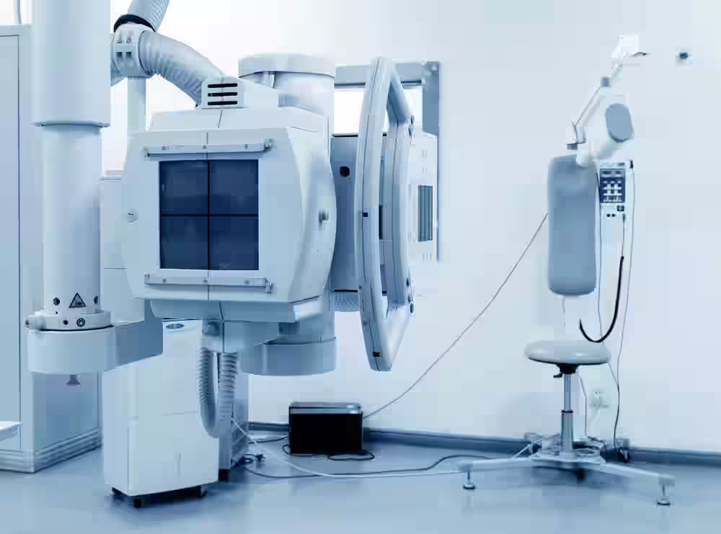


ScanMitra: Connecting
Patients to Diagnostic Centers
Your Companion for Smarter Diagnostic Appointments

Slide 2
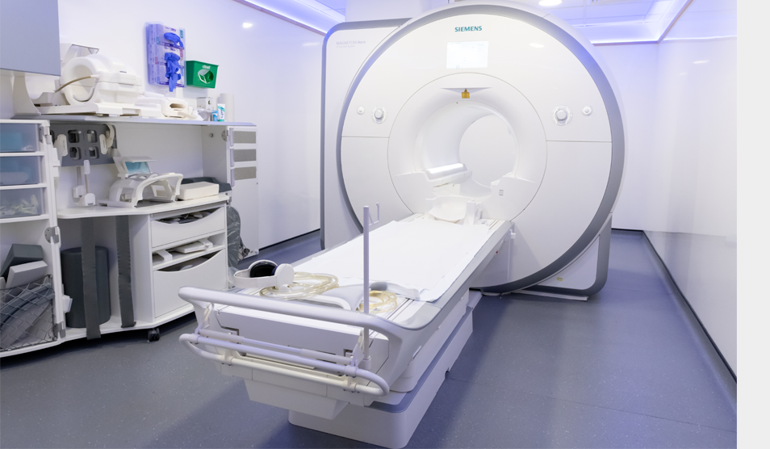
THE IDEA IS TO ACT AS A COMPANION OR ASSISTANT FOR PATIENTS WHO VISIT DIAGNOSTIC CENTERS FOR ULTRASOUND, X-RAY, OR SONOGRAPHY.

Slide 3

Problems Faced
PROBLEMS FACED BY PATIENTS (CUSTOMERS):
Long queues (2–3 hrs wait)
No real-time updates about waiting status
Uncertainty of turn
High stress for elderly & pregnant women
Wasted working hours for professionals
Overall frustration & poor experience
PROBLEMS FACED BY DIAGNOSTIC CENTERS:
Queue mismanagement
Revenue loss from walkouts
Unorganized data — no record of patient flow & peak times
Overcrowded reception
Idle machines/staff
No proper system to handle missed/canceled appointments

Slide 4



Solutions
SOLUTIONS FOR PATIENTS (CUSTOMERS):
SOLUTIONS FOR DIAGNOSTIC CENTERS:
Online booking of slots
Real-time queue visibility
Easy patient login
Waitlist management
Multi-center access
Customized portals
Follow-up system
Booking analytics
Efficient scheduling
Improved patient retention

Slide 5


WE NAMED OUR PROJECT SCANMITRA. THE IDEA IS TO REDUCE THE LONG WAITING HOURS AT DIAGNOSTIC CENTERS. IT CONNECTS PATIENTS WITH CENTERS THROUGH REAL-TIME SLOT BOOKING. IT SAVES TIME, REDUCES STRESS, AND MAKES THE WHOLE PROCESS SMOOTHER FOR BOTH PATIENTS AND CENTERS.

Slide 6
WHY ScanMitra?
VALUE FOR PATIENTS (CUSTOMERS):
VALUE FOR DIAGNOSTIC CENTERS:
Saves time
Improves patient experience
Enhances trust & transparency
Convenience & comfort
Loyalty to better centers
Reduces missed appointments
Smarter scheduling
Increases efficiency
Less crowding at reception desks
Professional branding
Increases patient loyalty (centers offering convenience will be preferred)

Slide 7
Tech Stacks
Frontend
next.js
Tailwind CSS or Bootstrap
Axios (API calls)
React Router
BACKEND Next.js and Express.js
FOR DATABASE : MongoDB
AUTHENTICATION: JWT(JSON Web Token)

Slide 8

CHANNELS:
Direct sales to diagnostic centers
Partnerships with clinics & doctors
Online marketing (Google Ads, Social Media)
Medical associations & local health fairs
On-ground marketing at clinics/labs
Collaborations with hospitals or health influencers

Slide 9
CUSTOMER RELATIONSHIPS & ENGAGEMENT:
· Easy support through chat/call
· Appointment reminders & notifications
· Feedback system post-appointment
· Regular updates & improvements

Slide 10
UI / UX WireFrame
https://excalidraw.com/#room=2bc3b250f2dccef4965d,9VbrJi_lmEQPrKvM84Kbjw

Slide 11

Future Sope:
Mobile App Launch (Android & iOS)
AI-based slot prediction & reminders
Digital payments & multi-language support
Integration with hospitals & doctors
Digital health records & history
Expansion to multiple cities

Slide 12
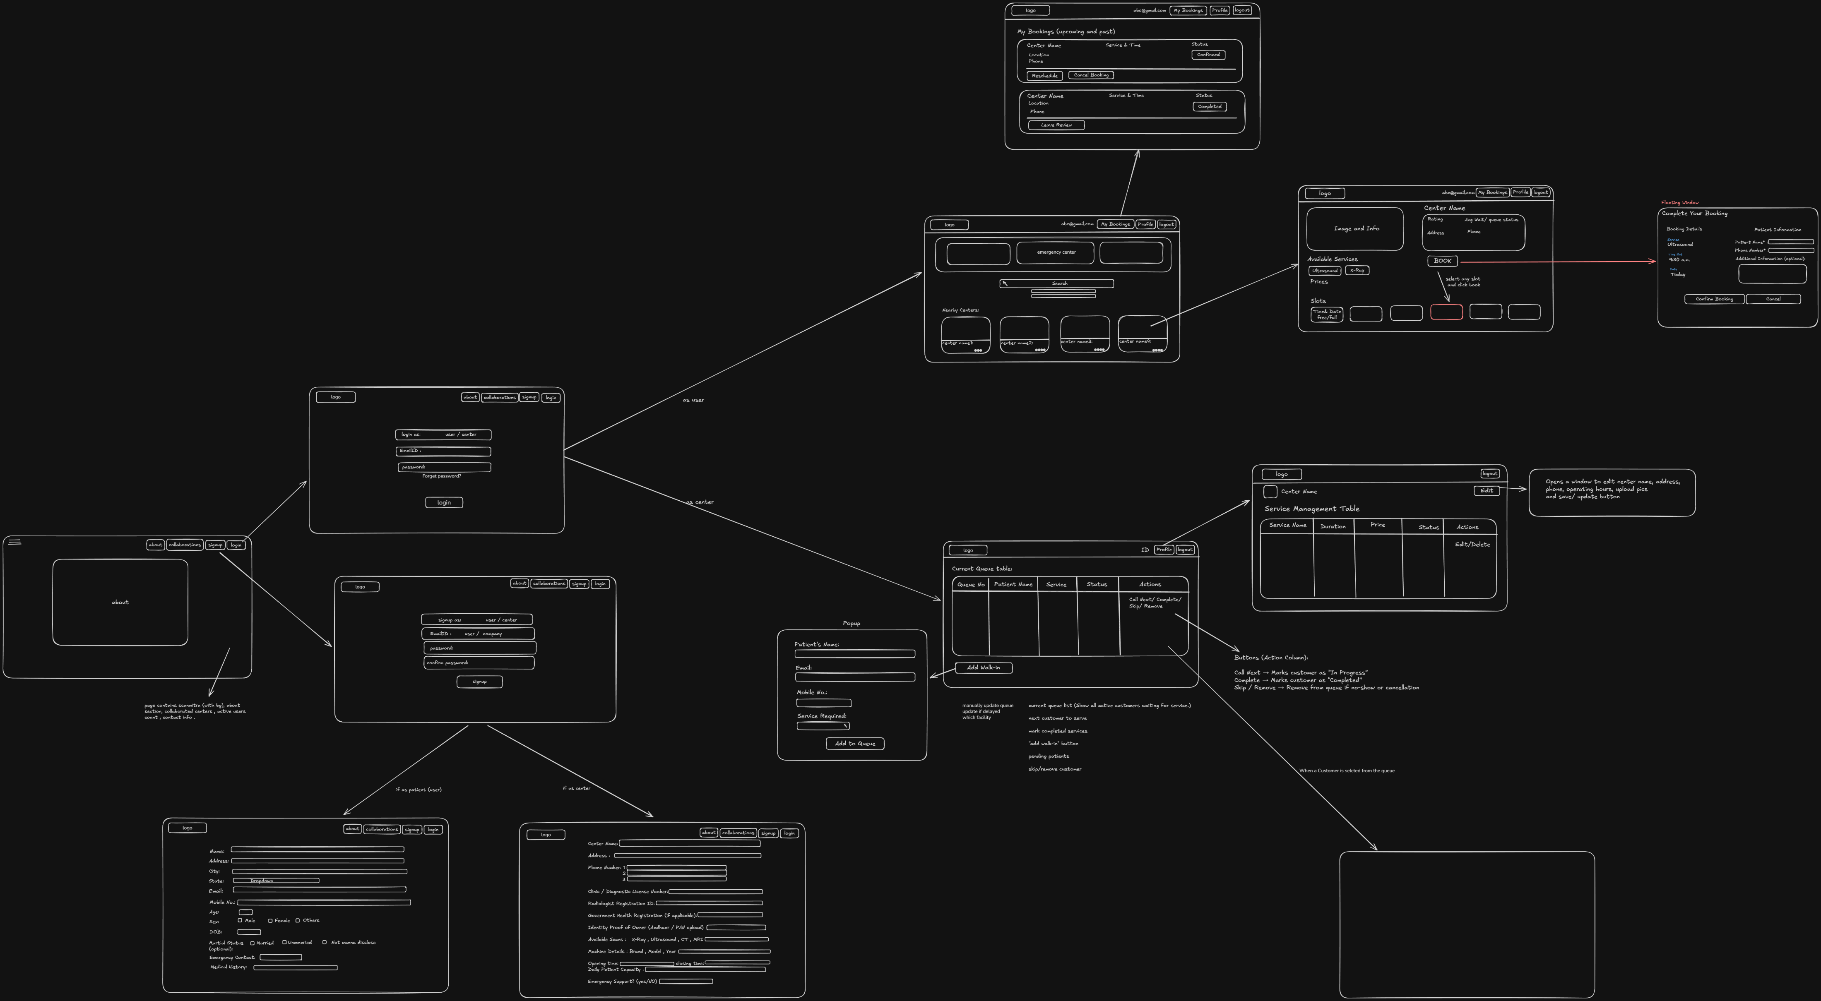
Thank you

Slide 13
Thank you

